Slide 1
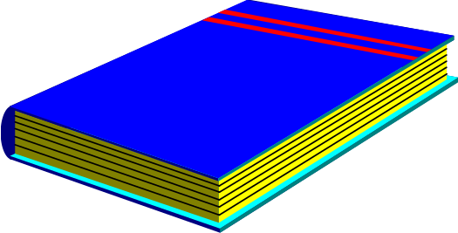
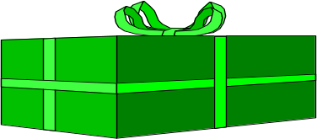
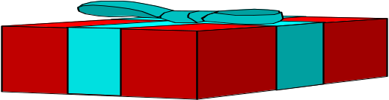
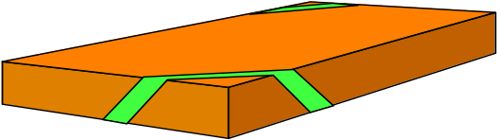
What is a stack?
It is an ordered group of homogeneous items.
Items are added to and removed from the top of the stack
LIFO property: Last In, First Out
The last item added would be the first to be removed
TOP OF THE STACK
TOP OF THE STACK
Notes:
Src: http://www.cse.unr.edu/~bebis/CS302/Lectures/Stacks.ppt

Slide 2
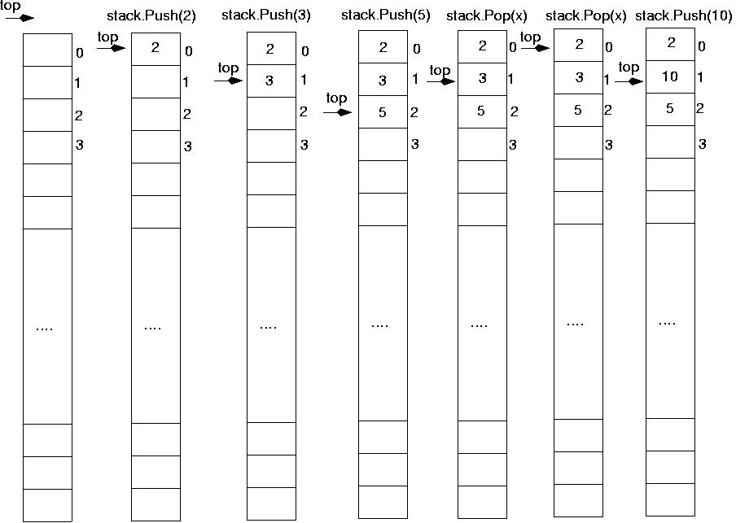
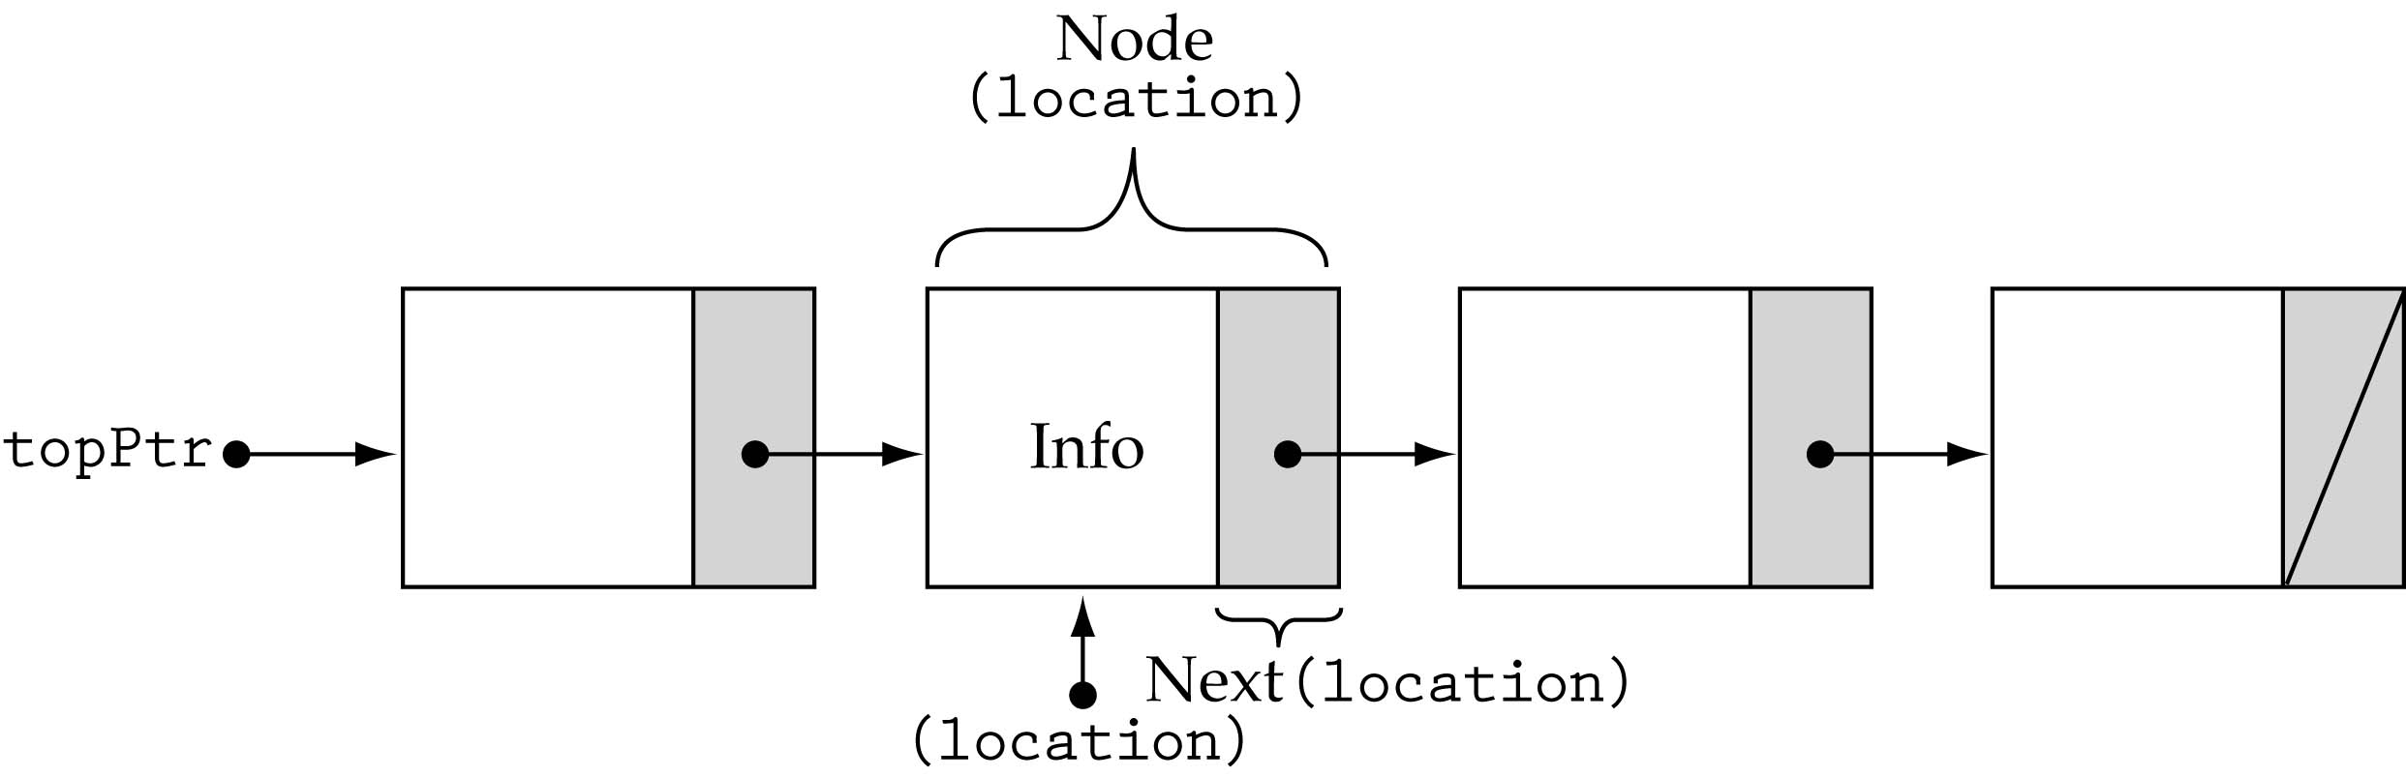
Stack Implementations
Array-based
Linked-list-based

Slide 3
Array-based Stacks
class StackType {
public:
StackType(int);
void MakeEmpty();
bool IsEmpty() const;
bool IsFull() const;
void Push(int);
void Pop(int&);
private:
int top, maxStack;
int *items;
};
dynamically allocated array

Slide 4
Array-based Stacks (cont’d)
StackType::StackType(int size)
{
top = -1;
maxStack = size;
items = new int[max];
}
StackType::~StackType()
{
delete [ ] items;
}
O(1)
O(1)

Slide 5
Array-based Stacks (cont’d)
void StackType::MakeEmpty()
{
top = -1;
}
O(1)

Slide 6
Array-based Stacks (cont.)
bool StackType::IsEmpty() const
{
return (top == -1);
}
bool StackType::IsFull() const
{
return (top == maxStack-1);
}
O(1)
O(1)

Slide 7
Push (int newItem)
Function: Adds newItem to the top of the stack.
Preconditions: Stack has been initialized and is not full.
Postconditions: newItem is at the top of the stack.

Slide 8
Stack overflow
The condition resulting from trying to push an element onto a full stack.
if(!stack.IsFull())
stack.Push(item);

Slide 9
Array-based Stacks (cont.)
void StackType::Push(int newItem)
{
top++;
items[top] = newItem;
}
O(1)

Slide 10
Pop (int& item)
Function: Removes topItem from stack and returns it in item.
Preconditions: Stack has been initialized and is not empty.
Postconditions: Top element has been removed from stack and item is a copy of the removed element.

Slide 11
Stack underflow
The condition resulting from trying to pop an empty stack.
if(!stack.IsEmpty())
stack.Pop(item);

Slide 12
Array-based Stacks (cont.)
void StackType::Pop(int& item)
{
item = items[top];
top--;
}
O(1)

Slide 13
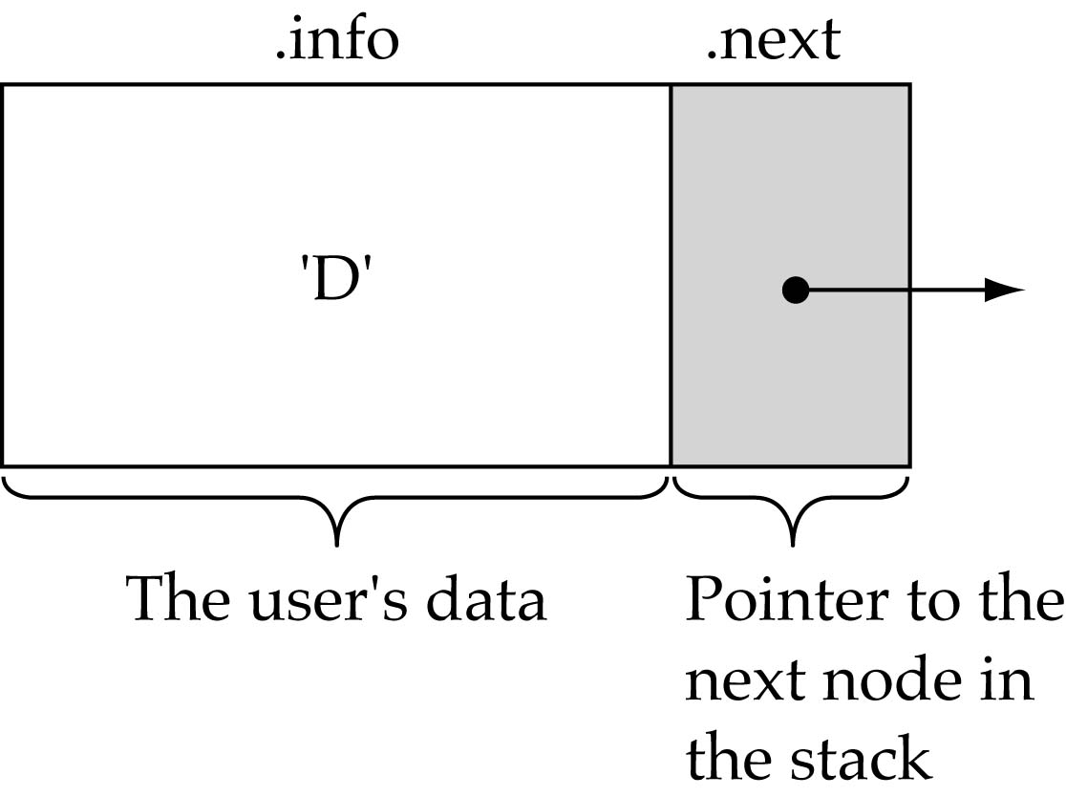
Linked-list-based Stacks
  struct NodeType {
  int info;
  NodeType* next;
  };

Slide 14
Linked-list-based Stacks (cont’d)
struct NodeType;
class StackType {
public:
StackType();
~StackType();
void MakeEmpty();
bool IsEmpty() const;
bool IsFull() const;
void Push(int);
void Pop(int&);
private:
NodeType* topPtr;
};

Slide 15
Linked-list-based Stacks (cont’d)
StackType::StackType()
{
topPtr = NULL;
}
void StackType::MakeEmpty()
{
NodeType* tempPtr;
while(topPtr != NULL) {
tempPtr = topPtr;
topPtr = topPtr->next;
delete tempPtr;
}
}
O(1)
O(N)

Slide 16
Linked-list-based Stacks (cont’d)
StackType::~StackType()
{
MakeEmpty();
}
O(N)
bool StackType::IsEmpty() const
{
return(topPtr == NULL);
}
O(1)

Slide 17
Push (int newItem)
Function: Adds newItem to the top of the stack.
Preconditions: Stack has been initialized and is not full.
Postconditions: newItem is at the top of the stack.

Slide 18
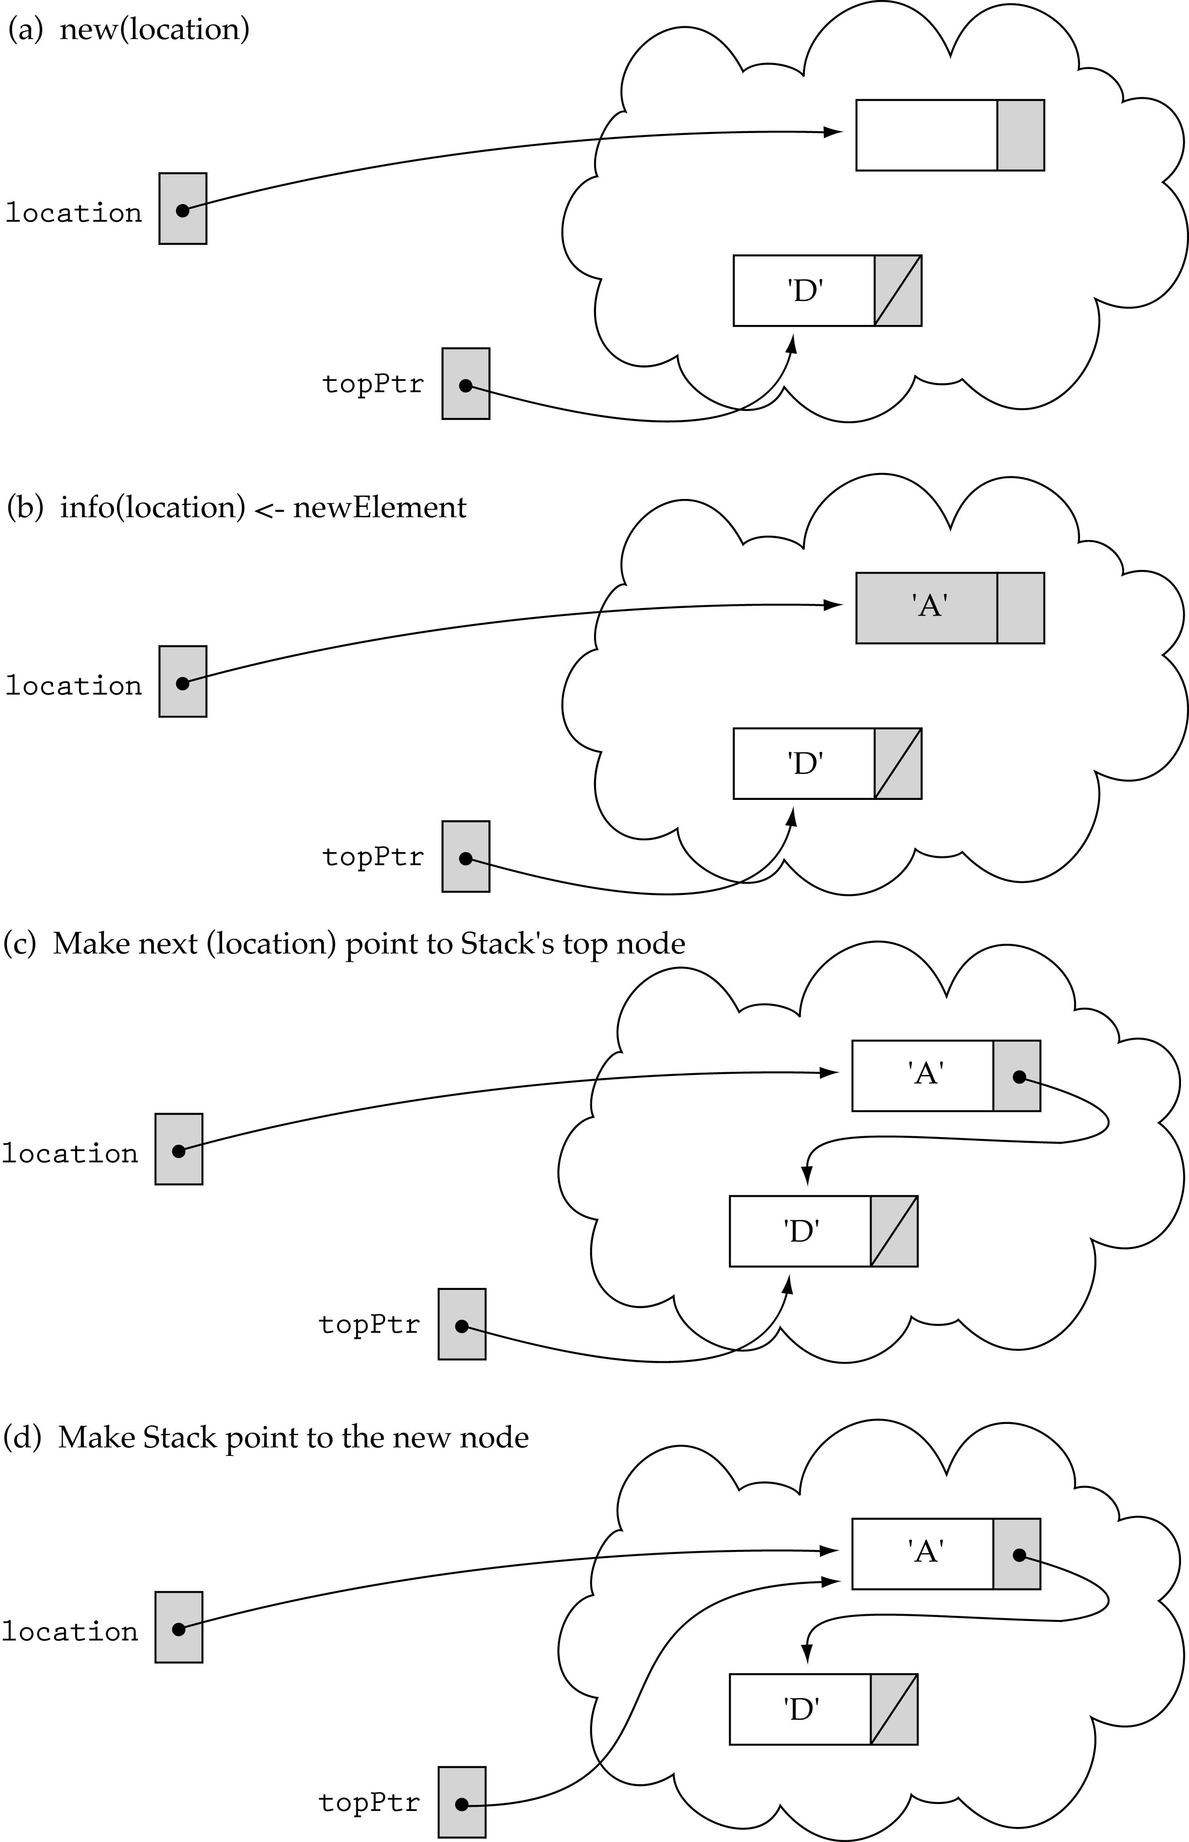
Pushing on a non-empty stack

Slide 19
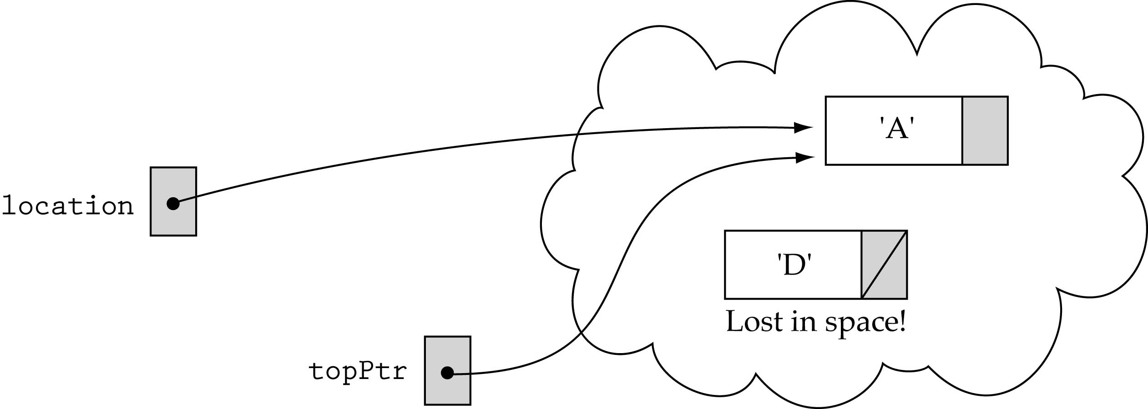
Pushing on a non-empty stack (cont.)
The order of changing the pointers is important!

Slide 20
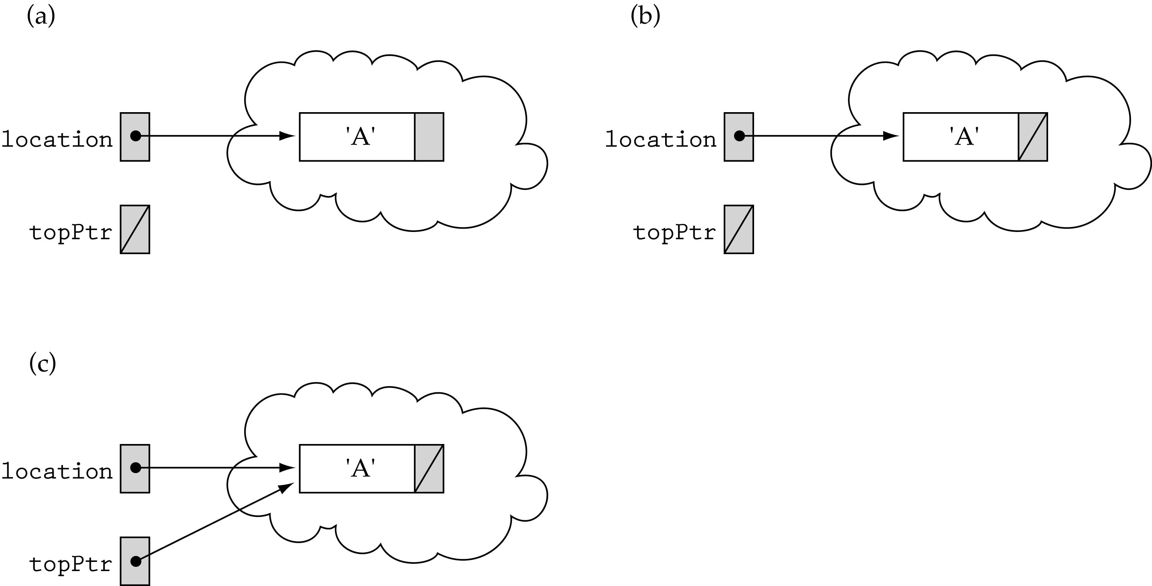
Special Case: pushing on an empty stack

Slide 21
Function Push
template <class int>
void StackType::Push(int item)
{
NodeType* location;
location = new NodeType;
location->info = newItem;
location->next = topPtr;
topPtr = location;
}
O(1)

Slide 22
Pop (int& item)
Function: Removes topItem from stack and returns it in item.
Preconditions: Stack has been initialized and is not empty.
Postconditions: Top element has been removed from stack and item is a copy of the removed element.

Slide 23
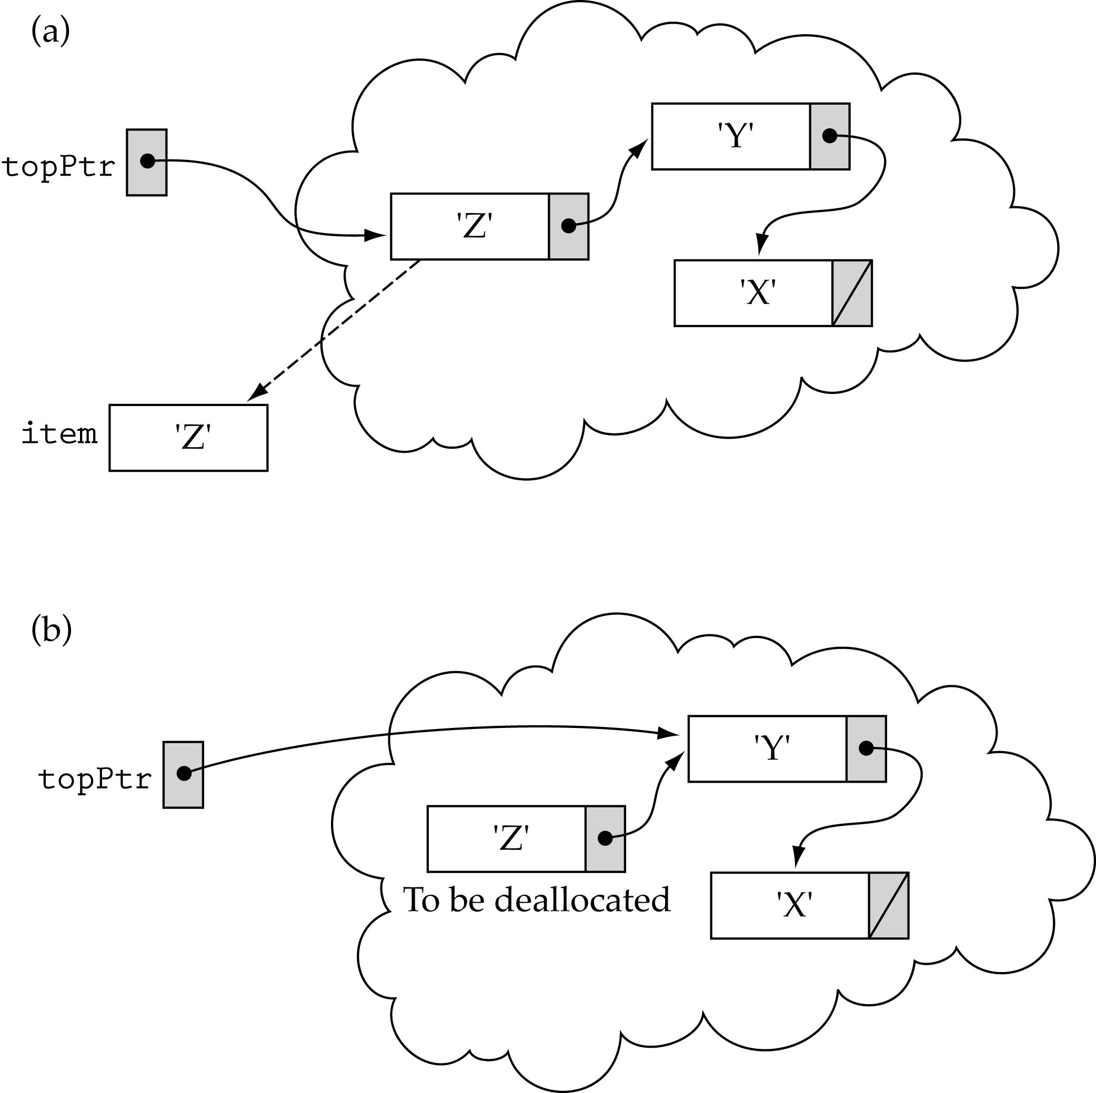
Popping the top element

Slide 24
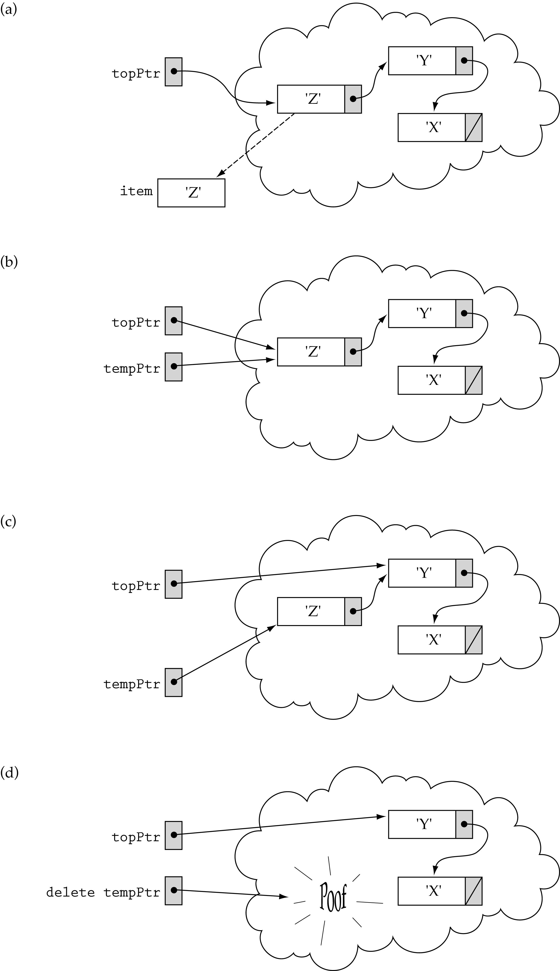
Popping the top element
(cont.)
Need a temporary pointer !

Slide 25
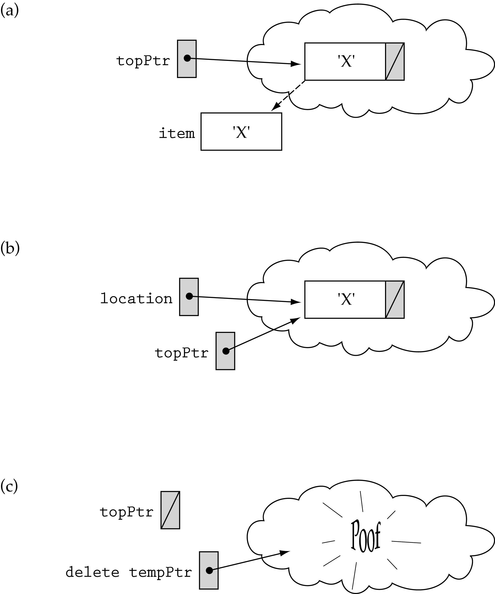
Special case: popping the last element on the stack
tempPtr

Slide 26
Function Pop
template <class int>
void StackType::Pop(int& item)
{
NodeType* tempPtr;
item = topPtr->info;
tempPtr = topPtr;
topPtr = topPtr->next;
delete tempPtr;
}
O(1)

Slide 27
Array-vs Linked-list-based
Stack Implementations
Array-based implementation is simple but:
  The size of the stack must be determined when a stack object is declared.
  Space is wasted if we use less elements.
  We cannot "enqueue" more elements than the array can hold.
Linked-list-based implementation alleviates these problems but time requirements might increase.

Slide 28
Example using stacks: evaluate postfix expressions
Postfix notation is another way of writing arithmetic expressions.
In postfix notation, the operator is written after the two operands.
infix: 2+5 postfix: 2 5 +
Why using postfix notation?
Precedence rules and parentheses are not required!

Slide 29
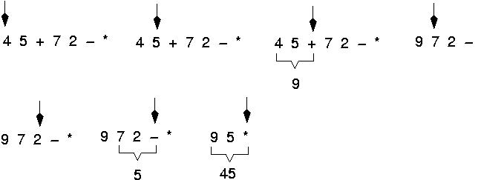
Example: postfix expressions
(cont.)
Expressions are evaluated from left to right.

Slide 30
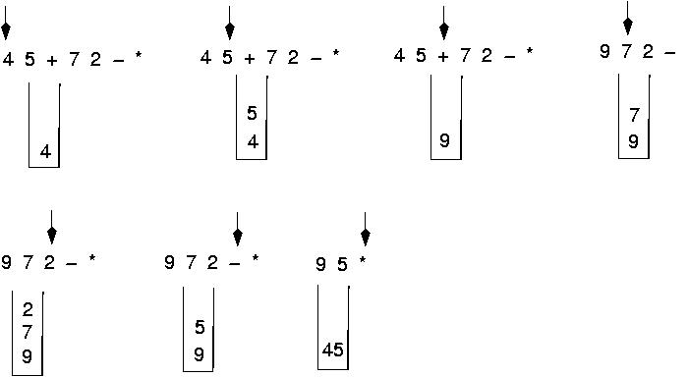
Postfix expressions:
Algorithm using stacks (cont.)

